Slide 1
Lesson 03 Discrete Random Variables
Concepts
E214 – Statistical Methods for Engineering

Slide 2
E214 – Statistical Methods for Engineering
Inferential Statistics
Hypothesis Testing
Parameter Estimation
Organise & summarise data collected
Probability and Distributions
Venn Diagram
Probability Distributions
Descriptive Statistics
Tree Diagram
Discrete Random Variables and Probability Distributions
Continuous Random Variables and Probability Distributions
Binomial Distribution
Poisson Distribution
Normal Distribution
Exponential Distribution
L03
A more detailed topic tree on Hypothesis Testing will be given from P08 onwards

Slide 3
Overview of Concepts
S/N | Concepts | Slide Number
1 | Discrete Random Variables | 5-6
2 | Continuous Random Variables | 7
3 | PMF for a Discrete Random Variable | 8-10
4 | CDF for a Discrete Random Variable | 11-13
5 | Expected Value of a Discrete Random Variable | 14-15
6 | Variance and Standard Deviation of a Random Variable | 16-17
7 | Examples to demonstrate application of concepts | 18-25
8 | Summary of learning objectives for L03 | 26
9 | E-learning video for L03 | 27

Slide 4
L01 Recap: Random Experiment
A random experiment is an experiment which fulfills all the following three conditions:
Multiple outcomes
Uncertainty of the outcomes
Repeatability
[Example 1]
A simple coin toss is a random experiment because:
It has 2 possible outcomes: Head or Tail
We are uncertain whether the outcome of each toss will be a Head or a Tail
We can repeat this experiment as many times as we want under identical conditions

Slide 5
Discrete Random Variables
A random variable (r.v.) is a numerical variable associated with some outcome of a random experiment. It can assume multiple possible values.
Random variables are denoted by capital letters (X, Y, etc.)
Possible values of a random variable are denoted by small letters (x, y, etc.)
A random variable can be categorised as either discrete or continuous.
A discrete random variable can assume only a finite or countably infinite number of possible values.
[Example 2]
Let X represent the number of Heads obtained when a coin is tossed 20 times.
X is a discrete r.v. because x = {0,1,2, …, 20}(finite number of possible values)

Slide 6
Discrete Random Variables
[Example 3]
Let Y represent the number of road accidents along AYE (Ayer Rajah Expressway) in a one-month period.
Y is a discrete r.v. as y = {0,1,2,3, …}.
Here, Y can be considered as having a countably infinite number of possible values. This is because although in practical situations, you cannot have an infinite number of accidents, you also cannot possibly define an upper limit for that.

Slide 7
Continuous Random Variables
A continuous r.v. can assume any value in the interval for which is it defined. There is an infinite number of possible values that it can assume within that interval.
[Example 4]
Let H = height (in cm) of a randomly chosen student in Republic Poly
[Example 5]
Let T = waiting time interval (in minutes) between successive bus arrivals for Bus No. 902 at Woodlands Bus Interchange
The focus for today’s lesson is on discrete random variables.
Notes:
Continuous variables are variables that can assume an infinite number of values in an interval (i.e. in decimal values). They are obtained from data that are measured rather than counted.

Slide 8
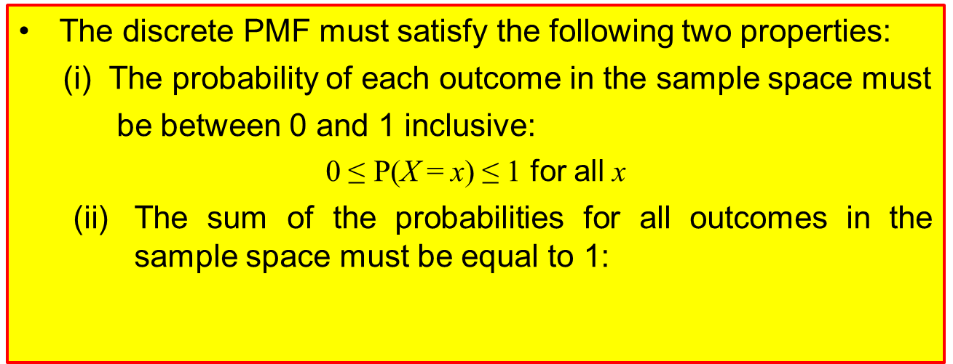
PMF for a Discrete Random Variable
A probability mass function (PMF) is a list of all possible values x that a discrete r.v. X can assume, together with their respective probabilities of occurrence denoted by P(X = x).
The PMF can be represented either as a table or a graph or a function of x.
P(X = x) represents the probability that the random variable X assumes the value x.
The discrete PMF must satisfy the following two properties:
(i) The probability of each outcome in the sample space must
be between 0 and 1 inclusive:
0 ≤ P(X = x) ≤ 1 for all x
The sum of the probabilities for all outcomes in the sample space must be equal to 1:

Slide 9
PMF for a Discrete Random Variable
[Example 6] Find the PMF for X, where
X represents the sum of the scores on two fair dice when they are thrown simultaneously
[Solution] The sample space table for the random experiment is as follows:
Score on 2nd dice
 | 1 | 2 | 3 | 4 | 5 | 6
1 | 2 | 3 | 4 | 5 | 6 | 7
2 | 3 | 4 | 5 | 6 | 7 | 8
3 | 4 | 5 | 6 | 7 | 8 | 9
4 | 5 | 6 | 7 | 8 | 9 | 10
5 | 6 | 7 | 8 | 9 | 10 | 11
6 | 7 | 8 | 9 | 10 | 11 | 12
Score on 1st dice
Each value is the sum of the scores on the 2 dice

Slide 10
PMF for a Discrete Random Variable
The possible values of X are x = {2,3,4,5, …, 12}.
The PMF of X is as follows:
Alternatively, we can also represent PMF of X as a graph:
x | 2 | 3 | 4 | 5 | 6 | 7 | 8 | 9 | 10 | 11 | 12
P(X = x) | 1/36 | 2/36 | 3/36 | 4/36 | 5/36 | 6/36 | 5/36 | 4/36 | 3/36 | 2/36 | 1/36

Slide 11
CDF for a Discrete Random Variable
The cumulative distribution function (CDF) of a r.v. X is denoted by F(x). It represents the probability that X assumes a value less than or equal to a value x.
The CDF can also be represented in the form of a table or a graph.
Basic properties of CDF:
(i) 0 ≤ F(x) ≤ 1
(ii) F(x) is a non-decreasing function.
(iii) For discrete r.v.s, F(x) is always a ‘step’ function.
F(x) = P(X ≤ x)
for all x ∈ ℝ (set of all real numbers)

Slide 12
CDF for a Discrete Random Variable
[Example 7]
Referring to Example 6, find the CDF of the r.v. X.
[Solution]
X | 2 | 3 | 4 | 5 | 6 | 7 | 8 | 9 | 10 | 11 | 12
P(X = x) | 1/36 | 2/36 | 3/36 | 4/36 | 5/36 | 6/36 | 5/36 | 4/36 | 3/36 | 2/36 | 1/36
F(x) | 1/36 | 3/36 | 6/36 | 10/36 | 15/36 | 21/36 | 26/36 | 30/36 | 33/36 | 35/36 | 36/36
Sample calculation:
F(6) = P(X ≤ 6)
= P(X = 2) + P(X = 3) + P(X = 4) + P(X = 5) + P(X = 6)
= 1/36 + 2/36 + 3/36 + 4/36 +5/36
= 15/36

Slide 13

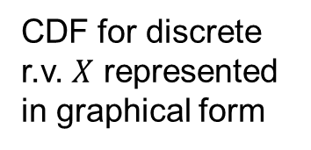
CDF for a Discrete Random Variable
CDF for discrete r.v. $X$ represented in graphical form
$$x$$

Slide 14
Expected Value of a Discrete Random Variable
The expected value of a discrete r.v. X (or called expectation of X, or mean value of X) is denoted by E(X) or µ. It is defined as
where x₁, x₂, …, x_{n} are all possible values of X and p₁, p₂, …, p_{n} are their corresponding probabilities.
In general, if g(X) is a function of X, then the expected value of g(X) is
E(X) is the long run theoretical average value of the random variable X when the particular random experiment is repeated many times. E(X) may not necessarily be one of the actual values of X.
Notes:
E(X) can be interpreted as the weighted average of all values in the sample space, where the weights are the probabilities. It is the theoretical or long-run average of the r.v.

Slide 15
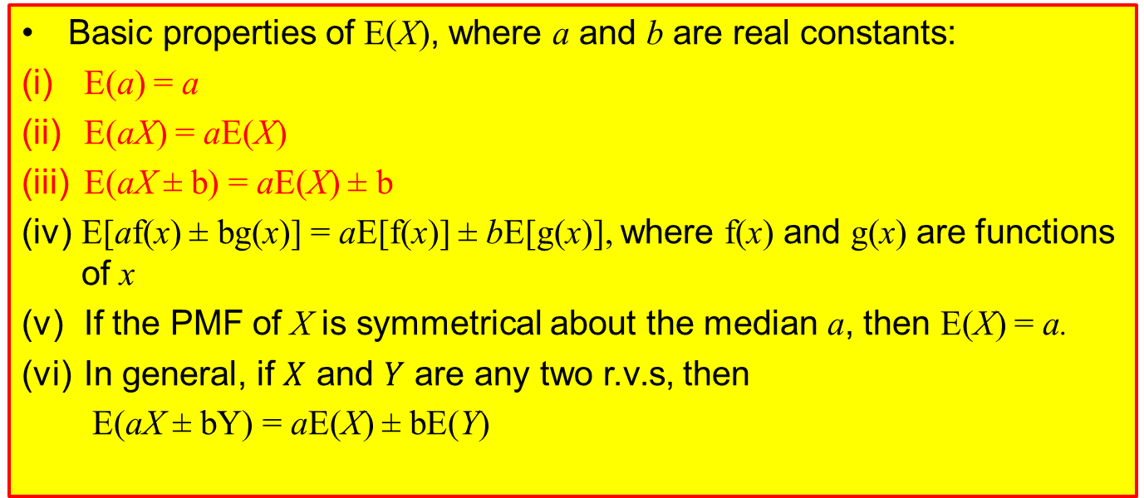
Expectation Algebra
Basic properties of E(X), where a and b are real constants:
(i) E(a) = a
(ii) E(aX) = aE(X)
(iii) E(aX ± b) = aE(X) ± b
(iv) E[af(x) ± bg(x)] = aE[f(x)] ± bE[g(x)], where f(x) and g(x) are functions of x
(v) If the PMF of X is symmetrical about the median a, then E(X) = a.
(vi) In general, if $X$ and $Y$ are any two r.v.s, then
E(aX ± bY) = aE(X) ± bE(Y)
[Example 9] Consider the r.v. X with PMF as shown:
x | 1 | 2 | 3 | 4 | 5 | 6
P(X = x) | 0.2 | 0.1 | 0.2 | 0.2 | 0.1 | 0.2
Observe that the PMF of X is symmetrical about the median, midway of 3 and 4. Therefore, E(X) = 3.5.

Slide 16
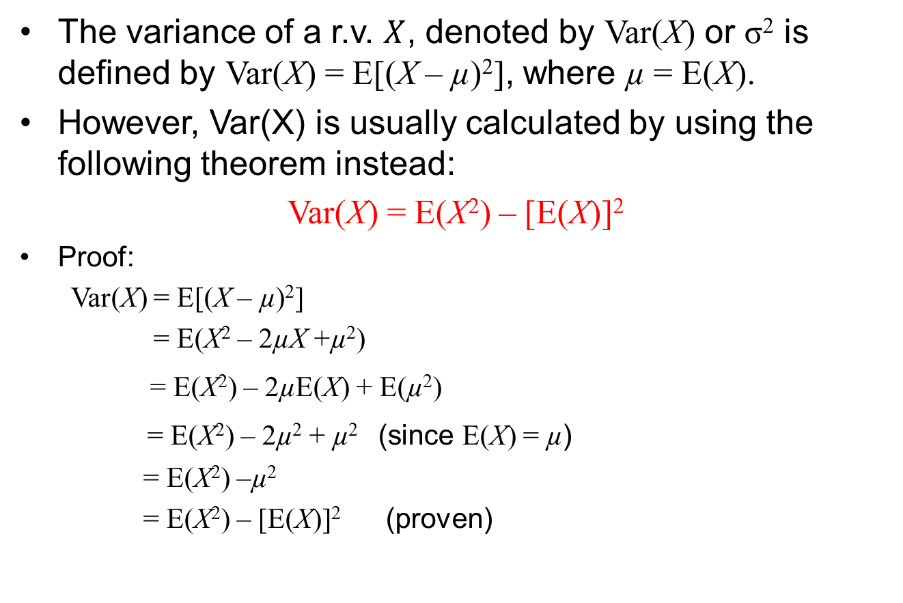
Variance and Standard Deviation of a Random Variable
The variance of a r.v. $X$, denoted by Var(X) or σ² is defined by Var(X) = E[(X – µ)²], where µ = E(X).
However, Var(X) is usually calculated by using the following theorem instead:
Var(X) = E(X²) – [E(X)]²
Proof:
Var(X) = E[(X – µ)²]
= E(X² – 2µX +µ²)
= E(X²) – 2µE(X) + E(µ²)
= E(X²) – 2µ² + µ² (since E(X) = µ)
= E(X²) –µ²
= E(X²) – [E(X)]² (proven)
Standard deviation of X,

Slide 17
Variance Algebra
Basic properties of Var(X), where a and b are real constants:
(i) Var(a) = 0
(ii) Var(aX) = a²Var(X)
(iii) Var(aX ± b) = a²Var(X)
(iv) In general, if X and Y are independent random variables, then
Var(aX ± bY) = a²Var(X) + b²Var(Y)
Always a plus sign!

Slide 18
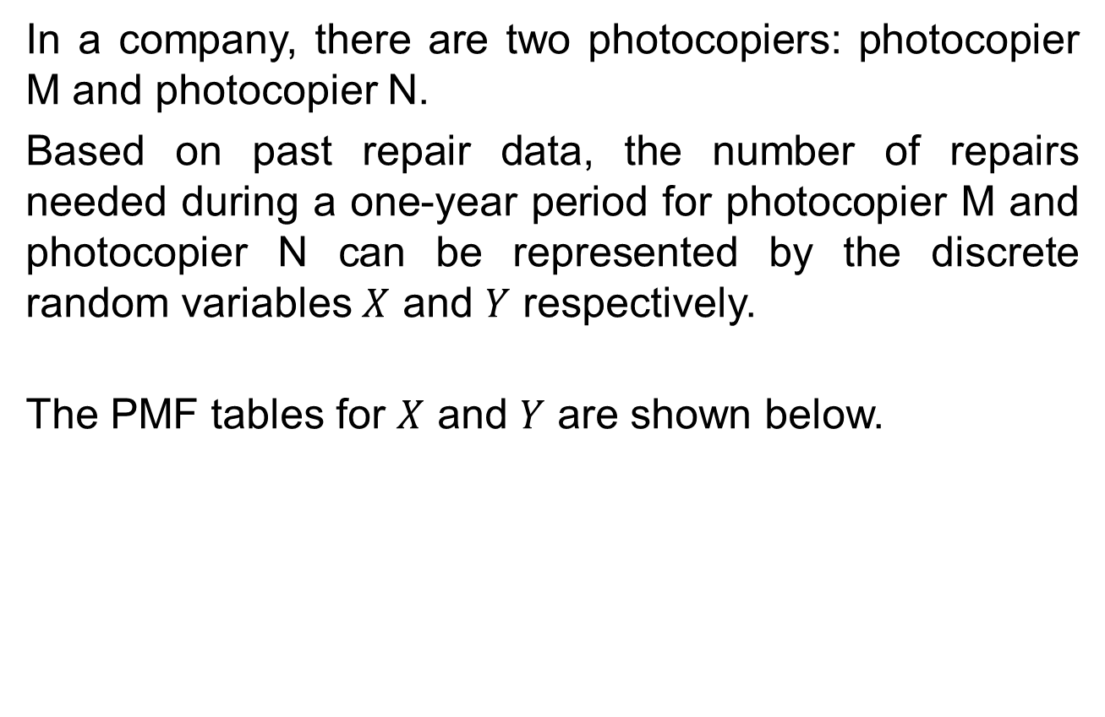
Example 10
In a company, there are two photocopiers: photocopier M and photocopier N.
Based on past repair data, the number of repairs needed during a one-year period for photocopier M and photocopier N can be represented by the discrete random variables $X$ and $Y$ respectively.
The PMF tables for $X$ and $Y$ are shown below.
x | 0 | 1 | 2 | 3
P(X = x) | 0.5 | p | 0.1 | 0.2
Photocopier M
y | 0 | 1 | 2
P(Y = y) | 0.8 | 0.1 | 0.1
Photocopier N

Slide 19
Example 10
Calculate the value of p.
Calculate the expected number of repairs during a one-year period for each photocopier, i.e. E(X) and E(Y).
Calculate the variance in the number of repairs needed during a one-year period for each photocopier, i.e. Var(X) and Var(Y).
If it costs $250 per repair for photocopier M and $400 per repair for photocopier N, calculate the expected total cost for repair work during a one-year period, and the standard deviation in this total cost.

Slide 20
Example 10
[Solution]
a)
p = 1 – 0.5 – 0.1 – 0.2 = 0.2
E(X) = 0(0.5) + 1(0.2) + 2(0.1) + 3(0.2) = 1
E(Y) = 0(0.8) + 1(0.1) + 2(0.1) = 0.3
x | 0 | 1 | 2 | 3
P(X = x) | 0.5 | p | 0.1 | 0.2
y | 0 | 1 | 2
P(Y = y) | 0.8 | 0.1 | 0.1

Slide 21
Example 10
c)
E(X²) = 0²(0.5) + 1²(0.2) + 2²(0.1) + 3²(0.2) = 2.4
E(Y²) = 0²(0.8) + 1²(0.1) + 2²(0.1) = 0.5
Var(X) = E(X²) – [E(X)]² = 2.4 – (1)² = 1.4
Var(Y) = E(Y²) – [E(Y)]² = 0.5 – (0.3)² = 0.41
x | 0 | 1 | 2 | 3
P(X = x) | 0.5 | p | 0.1 | 0.2
y | 0 | 1 | 2
P(Y = y) | 0.8 | 0.1 | 0.1

Slide 22
Example 10
d) Let C be the total cost of repair during a one-year period.
C = 250X + 400Y
Expected total cost of repair,
E(C) = E(250X + 400Y)
= 250E(X) + 400E(Y)
= 250(1) + 400(0.3)
= $370
Variance in total cost,
Var(C) = 250²Var(X) + 400²Var(Y)
= 250²(1.4) + 400²(0.41)
= 153100
Standard deviation of C,

Slide 23
Example 11
A discrete random variable X has the following PMF:
Calculate a.
Find E(X) and Var(X).
Find E(2X – 3) and Var(2X – 3).
Find Var(X²).
[Solution]
(a) a + 0.5 + 0.25 + 0.125 + 0.0625 = 1
a = 0.0625
(b)
x | 0 | 1 | 2 | 4 | 8
P(X = x) | a | 0.5 | 0.25 | 0.125 | 0.0625
Notes:
Put a problem context for example 10, prefer to be OP related.

Slide 24
Example 11
Var(X) = E(X²) – [E(X)]²
= 7.5 – 2²
= 3.5
E(2X – 3) = 2E(X) – 3
= 2(2) – 3
= 1
Var(2X – 3) = 2²Var(X)
= 4(3.5)
= 14

Slide 25
Example 11
(d)
Var(X²) = E(X⁴) – [E(X²)]²
= 292.5 – (7.5)²
= 236.25

Slide 26
Learning Objectives
Explain the difference between discrete and continuous random variables
Construct probability mass function (PMF) and cumulative distribution function (CDF) for a discrete random variable
Explain and apply the properties of PMF and CDF
Apply the formulae to calculate expectation and variance of a discrete random variable

Slide 27
E-Learning Video
You are strongly encouraged to watch the e-learning video prepared for L03 to enhance your understanding of the main learning objectives.
You can access the e-learning video from the following link:
https://drive.google.com/file/d/0B0VVo-P5cYtqclNSSTlxRmR3SE0/edit?usp=sharing

